Slide 1

ＩＲ Presentation
December, 2014

Slide 2

The forward-looking statements and projected figures concerning the future performance of NTT
and its subsidiaries and affiliates contained or referred to herein are based on a series of
assumptions, projections, estimates, judgments and beliefs of the management of NTT in light of
information currently available to it regarding NTT and its subsidiaries and affiliates, the economy
and telecommunications industry in Japan and overseas, and other factors. These projections
and estimates may be affected by the future business operations of NTT and its subsidiaries and
affiliates, the state of the economy in Japan and abroad, possible fluctuations in the securities
markets, the pricing of services, the effects of competition, the performance of new products,
services and new businesses, changes to laws and regulations affecting the telecommunications
industry in Japan and elsewhere, other changes in circumstances that could cause actual results
to differ materially from the forecasts contained or referred to herein, as well as other risks
included in NTT’s most recent Annual Report on Form 20-F and other filings and submissions
with the United States Securities and Exchange Commission.
* “E” in this material represents that the figure is a plan or projection for operation.
‐ 1‐

Slide 3
Medium-term Financial Targets

Slide 4
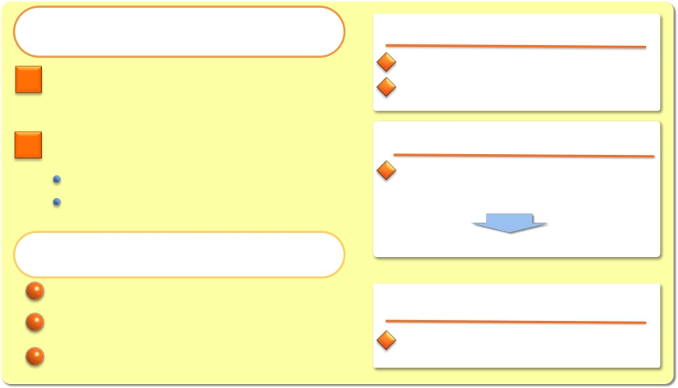

Medium-term Financial Targets (Announced on November 8, 2012)
The Path to Profit
Recovery and Growth
“Global Cloud Services” as the
cornerstone of NTT’s business
operations
Comprehensively strengthen
network service competitiveness
Further Improvement of Facility Efficiency
Establishment of Simple and Highly Efficient Business
Operations Tailored to Future Market Changes
Cash Control and its
Effective Utilization
Streamlining capital investment
Increasing M&A with a focus on
Cloud-related businesses
Enhancing shareholder returns
in the medium term
By the fiscal year ending March 31, 2017:
Overseas sales: $20 billion
Proportion of corporate sales represented
by overseas sales: 50% or more
By the fiscal year ending March 31, 2015:
At least 400 billion yen in cost reductions
in fixed-line/mobile access networks
(compared with the fiscal year ended March 31, 2012)
Revised to 600 billion yen in cost reductions
By the fiscal year ending March 31, 2016:
Capex to Sales: 15%
EPS growth of 60% or more by the fiscal year ending
March 31, 2016 (compared with the fiscal year ended March 31, 2012)
IR Presentation (December, 2014)
‐ 3‐
Copyright©2014 Nippon Telegraph and Telephone Corporation

Slide 5
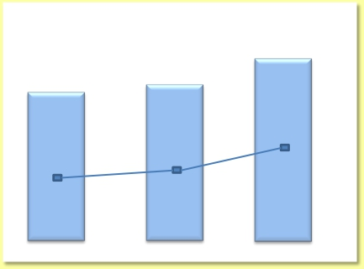
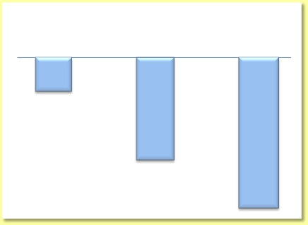
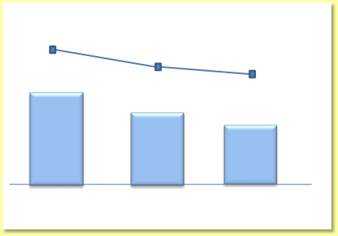
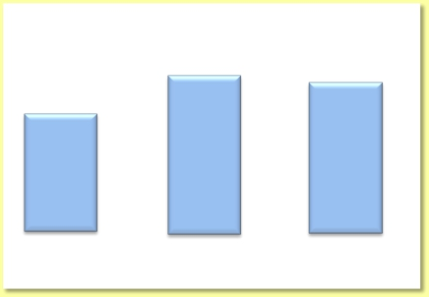
Progress of the Medium-term Financial Targets
Overseas Sales
Cost reductions in
fixed-line/mobile access networks
2015/3 Eended/ing
（Fiscal year
2013/3
2014/3
（Billions of yen）
15.0
March 31）
12.0
Billion USD
31.8%
12.2
Billion USD
36.6%
Billion USD
43.1%
▲▲ 120*
Percentage of sales to
overseas corporations
2014/3
▲▲ 410*
* Compared to fiscal year ended 2012/3
（Fiscal year
ended/ing
March 31）
2013/3
2015/3 E
▲▲ 600*
Capital Investment（（Capex to Sales）
（Billions of yen）
EPS
（Yen/Share）
509
＋39％**
479
＋31％**
18. 1%*
1, 907. 5*
16. 7%*
1, 795. 7*
16. 1%*
1, 750. 0*
431
＋17％**
39％
31％
17％
（Fiscal year
2013/3 2014/3 2015/3 EMarch 31）
* Compared to fiscal year ended 2012/3
(Note) Fiscal year ended 2014/3 EPS is 477 yen(30% increase) when excluding the effect
of non-operating income relating to the Otemachi 2-chome area redevelopment project.
（Fiscal year
ended/ing
March 31）
2015/3 E2014/32013/3
* Amounts does not include sales and investments related to real estate and
solar power generation operations
ended/ing
IR Presentation (December, 2014)
‐ 4‐
Copyright©2014 Nippon Telegraph and Telephone Corporation

Slide 6
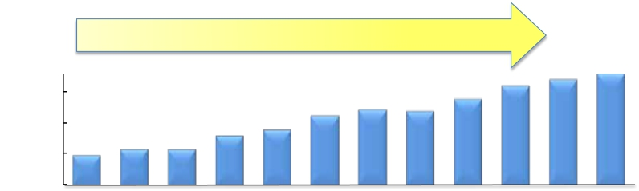
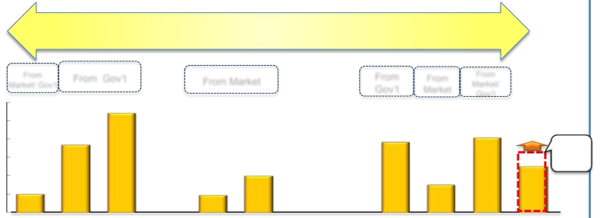

Shareholder Returns
Increased by More Than 3 Times
180
（yen）
Dividend
150
100
50
Dividends per share
50
0
（Fiscal year
ended/ing
2004/3
2005/3
2006/3
2007/3
2008/3 2009/3 2010/3 2011/3 2012/3 2013/3
2014/3
2015/3E
March 31）
More Than 2 Trillion Yen in Buy Backs
ShareBuyBacks
(Billions of yen)
From Gov’t
6,000
5,000
366.54,000
3,000
2,000 100.0
（Fiscal year
ended/ing
From
From Market
200.0
94.4
From
Gov’t Market
381.7 406.5
150.0
From
From
Market/ Gov’t
Market/
600 539.4
Gov’t
※ 2
350.0
（max）
Raised the
max amount
in2014.11
256.6
400
300
200
1,000
100
0
～2015/6E
March 31）
2004/3
2005/3
2006/3
2007/3
2008/3 2009/3 2010/3 2011/3
2012/3 2013/3 2014/3
※ 1:Market 61 billion yen, Gov’t 39 billion yen
IR Presentation (December, 2014)
※ 2:Market 250.0 billion yen, Gov’t 156.5 billion yen
Copyright©2014 Nippon Telegraph and Telephone Corporation
‐ 5‐

Slide 7
Global Cloud Services

Slide 8
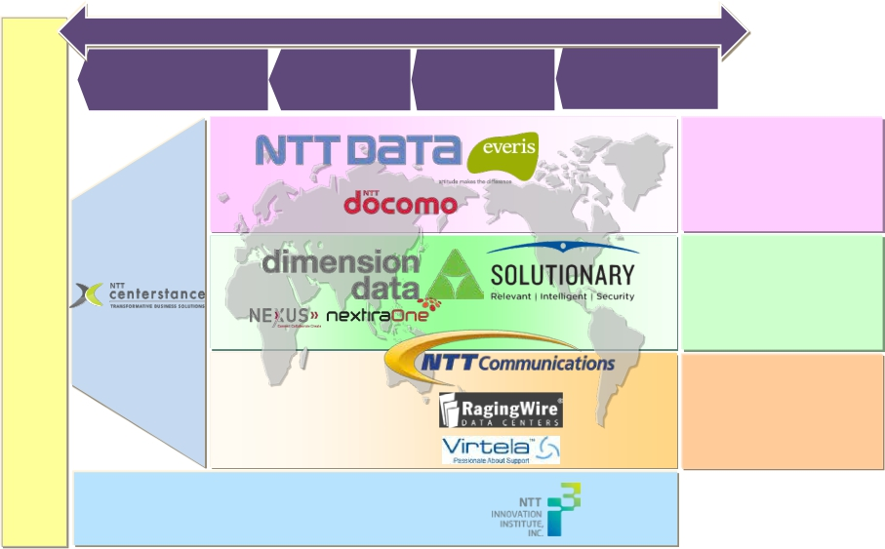
Global Cloud Business Promotion System
Provides full stack, full life- cycle service
Cloud Services
Advisory
Services
IR Presentation (December, 2014)
Migration
Services
R&D
Operation
Services
‐ 7‐
Management
Services
Applications
Solutions
Managed ICT
Data Centers
Networks
Copyright©2014 Nippon Telegraph and Telephone Corporation
Corporate Customers

Slide 9
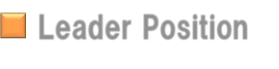



Our Strengths in Global Cloud Services
Leader Position
Gartner’ s Magic Quadrant
Gartner’ s Magic Quadrant
Communications Outsourcing and Professional Services
Global Network Service Providers＊（NTT Communications）
＊
（dimension data）
World- classclass in Global IP Backbone
(Traffic volume (Source: Renesys Corporation))
World’ s No.1 in Data Centerin Data Center
（NTT Group）
(Total floor space: Approx. 1 million㎡(as of the endofMarch 2014))
（NTT Communications）
80%of Fortune Global 100 choose NTT
of Fortune Global 100 choose NTT Group
Salesforce.com’ s Platinum Cloud Alliance Partner
（NTT Centerstance, NTT Data）
＊
Source: Gartner, " Magic Quadrant for Communications Outsourcing and Professional Services " Christine Tenneson, et al. 4 November 2014
" Magic Quadrant for Global Network Service Providers " Neil Rickard,et al. 20 March 2014
The Gartner Report( s) described herein, ( the “Gartner Report( s) ”) represent( s) data, research opinion or viewpoints published, as part of a syndicated subscription service, by Gartner, Inc. ( “Gartner”) , and are not
representations of fact. Each Gartner Report speaks as of its original publication date ( and not as of the date of this enterprise report) and the opinions expressed in the Gartner Report( s) are subject to change
without notice. Gartner does not endorse any vendor, product or service depicted in its research publications, and does not advise technology users to select only those vendors with the highest ratings or other
designation. Gartner research publications consist of the opinions of Gartner's research organization and should not be construed as statements of fact. Gartner disclaims all warranties, expressed or implied, with respect
to this research, including any warranties of merchantability or fitness for a particular purpose.
IR Presentation (December, 2014)
‐ 8‐
Copyright©2014 Nippon Telegraph and Telephone Corporation

Slide 10


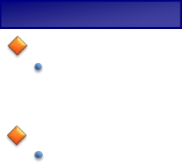
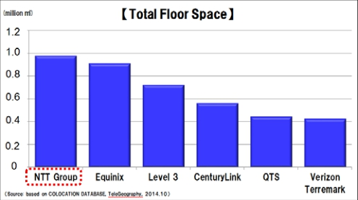
Our Strengths in Global Cloud Services
Network
Scale：
・Provides service in 196 countries/ areas
・World- class in Global IP backbone traffic
(Source: Renesys Corporation)
Quality：
・Lowest network latency between J apan / US / major countries in Asia
Data Center
Scale：
・World’ s No.1 in total floor space
( Approx. 1 million ㎡) (Source: TeleGeography)
Quality：
・High- quality lineup( TierⅣ sites)
IR Presentation (December, 2014)
‐ 9‐
Copyright©2014 Nippon Telegraph and Telephone Corporation

Slide 11

Expansion of Cross-Selling (Contract Value)
700M
（USD）
NTT Group has raised its brand
awareness in the global market,
leading to an increase of new
deals with global enterprises
143M
85M
2012/ 3
62M
2011/ 3
2013/ 3
2014/ 3
IR Presentation (December, 2014)
‐ 10‐
Copyright©2014 Nippon Telegraph and Telephone Corporation

Slide 12
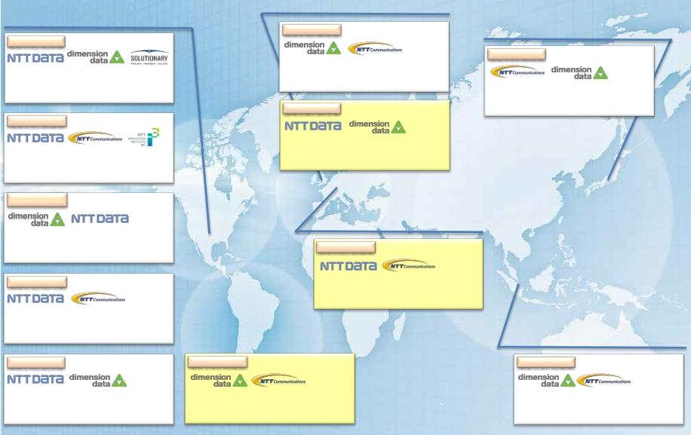
Cross Selling Track Record
Improved brand awareness leads to more deals with global enterprises
UK
US
2014/ 3.3Q
J apan
2014/ 3.1Q
Consumer Products Manufacturer
2014/ 3.3Q
Texas Department of Transportation
Ø
Global ＬＡＮ・ＷＡＮ construction
Ø
Ø
Cloud solution, Application, Maintenance
ＩＴＯ, Total security service
ＩＴＯØ
2015/ 3.1Q
ANA
Implementation and operation of
UCaaS（Could communication service）
Ø
2014/ 3.2Q
HM Treasury
Cloud, Business platform construction
Network infrastructure construction
Ｙｕｍ！Brands, Inc.
Cloud solution, Application, Maintenance
ＢＰＯ、ＩＴＯ
Ø
Ø
Ø
Ø
2014/ 3.2Q
System company
Germany
Ø
Ø
Cloud wholesale service
ＩＴＯ
2015/ 3.2Q
2014/ 3.4Q
Auto Manufacturer
Ø
Ø
Application support（ＡＭＯ）
Dater Center service
Healthcare Manufacturer
Transition of ＥＲＰto Cloud service
ＩＴＯ
Ø
Ø
Singapore
2014/ 3.4Q
Heavy Industries
2015/ 3.2Q
Financial Institution
2014/ 3.2Q
May Bank
Ø
Ø
Business platform construction
ＩＴＯ
Ø
Ø
Dater Center service
DC equipment procurement, implementation
Ø
Ø
Dater Center service
DC equipment procurement, implementation
IR Presentation (December, 2014)
‐ 11‐
Copyright©2014 Nippon Telegraph and Telephone Corporation

Slide 13
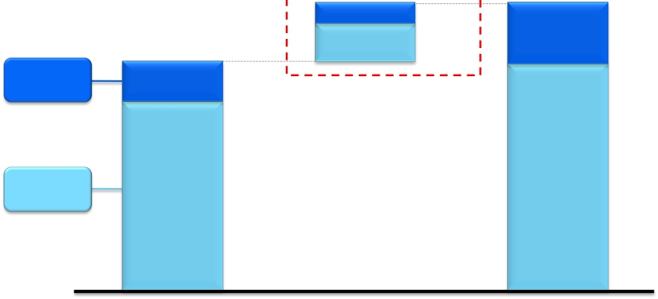
IT Spending ※ 1 Forecast
$410 billion
$1,830 billion
110
300
（27%）
（73%）
300
（16%）
$1,420 billion
19
Developing
Countries
※ 2
Developed
Countries
※ 3
190
1,230
（13%）
（87%）
20
20
1,530
114
（84%）
95
2012
Growth
2012- 20182018
2018
（E））
Source: Gartner, "Forecast: Enterprise IT Spending by Vertical Industry Market, Worldwide, 2012- 2018, 4Q13 Update" 08 October 2014 ,
Charts/ graphics created by NTT based on Gartner research.
※ 1 IT Spending
※ 2 Developing Countries
※ 3 Developed Countries
: Software, IT Services, Datacenter ( Excluding Internal Services, Devices and Telecom Services.)
: Latin America, Emerging Asia/ Pacific, Greater China, Eastern Europe, Eurasia, MEA, Sub- Saharan Africa
: North America, Western Europe, Mature APAC
IR Presentation (December, 2014)
‐ 12‐
Copyright©2014 Nippon Telegraph and Telephone Corporation

Slide 14
Network Services

Slide 15
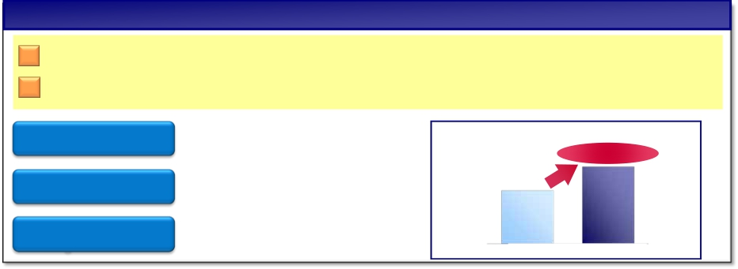
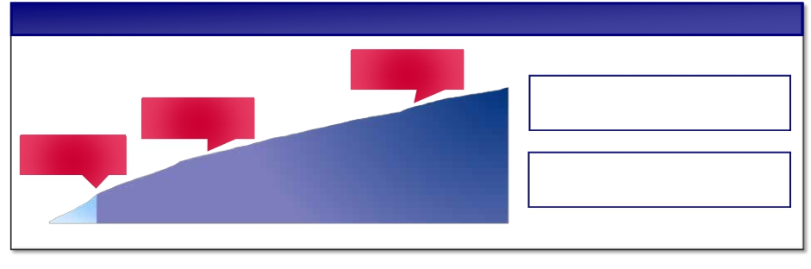
NTT DOCOMO’s New Billing Plan
Basic Concept
Shifting from “switching users among carriers” to “customer retention”
Flat rate for declining voice usage, measured rate for increasing data usage
Packet Sharing
Flat rate for calls
Discount for
long-termusers
Beneficial for families and for one
Beneficial for 2 or more devices
Flat rate for domestic calls
Beneficial billing plans for
long- term users
Increase in Total Packet Traffic
Up1.5-fold
2014/3.1H 2015/3.1H
Transition of Subscribers
No. of subs: Topped 10 million
Oct. 14, 2014:
Over 10 mil
Building a strong customer base
by improving churn rate and net adds
Jul. 5, 2014:
Over 5 mil
At service launce:
2.08 mil
subscribers
pre- orders
IR Presentation (December, 2014)
Lower sales cost by
shifting to customer retention
Copyright©2014 Nippon Telegraph and Telephone Corporation
No. of
No. of
‐ 14‐

Slide 16

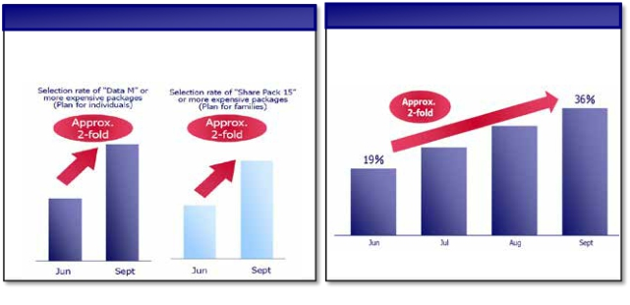
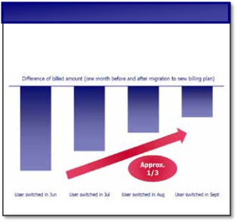
Upselling strategies and recovering profits
Profits are expected to recover gradually
2015/ 3
Impact on
profits
▲ ４０billion yen ( actual)
▲ ６０billion yen ( estimate)
（YoY）
Jun Jul Aug Sep Oct Nov Dec Jan Feb Mar
Recovery Trend ( 1)
Selection rate of larger data buckets:
on the increase
IR Presentation (December, 2014)
Recovery Trend ( 2)
Proportion of users with upside
potential on the increase
＊users with upside potential: user segments that offer usage
growth potential after switching to new billing plan
‐ 15‐
Recovery Trend ( 3)
Revenue drop caused by migration
to new billing plan
Copyright©2014 Nippon Telegraph and Telephone Corporation

Slide 17
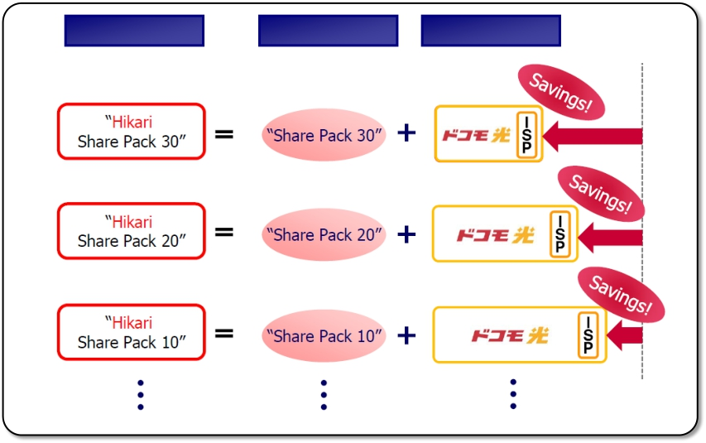
“docomo Hikari Pack” Concept
Guide subscribers to larger data plan by offering steeper discounts
Gain new subscribers by bundling mobile with fixed line ( FTTH)
“docomo Hikari Pack”
IR Presentation (December, 2014)
New Billing Plan
‐ 16‐
“docomo Hikari”
Copyright©2014 Nippon Telegraph and Telephone Corporation

Slide 18
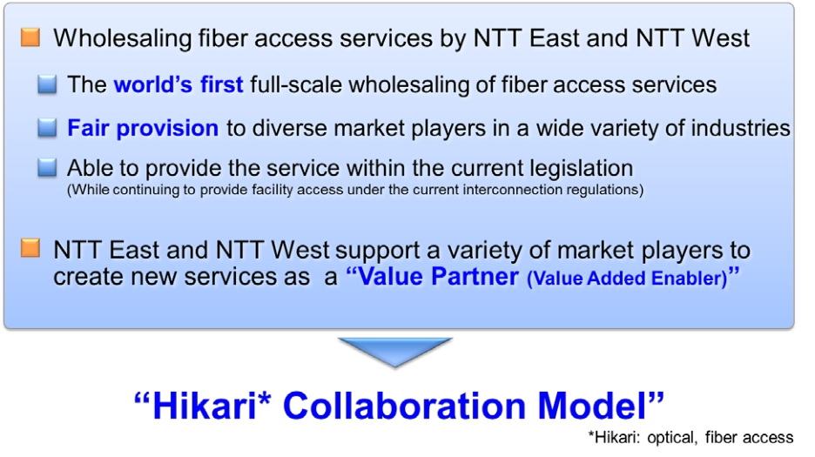
Hikari Collaboration Model
IR Presentation (December, 2014)
‐ 17‐
Copyright©2014 Nippon Telegraph and Telephone Corporation

Slide 19
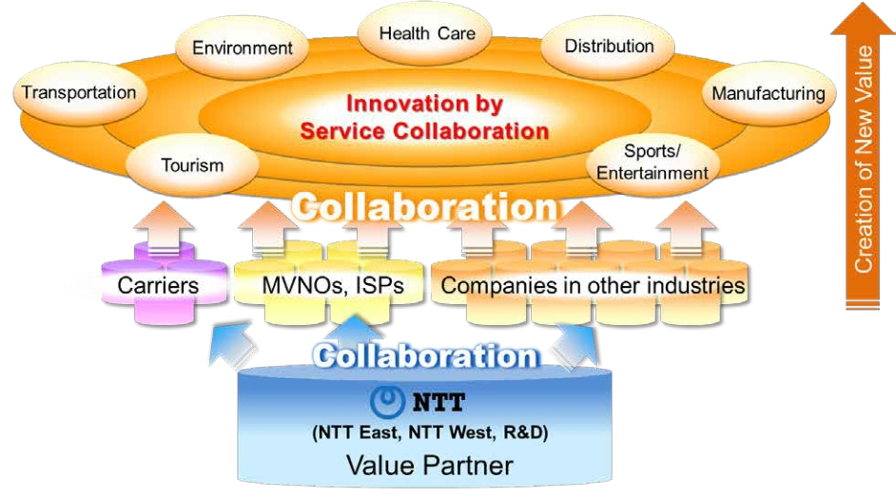
Creation of Value through Collaboration
IR Presentation (December, 2014)
‐ 18‐
Copyright©2014 Nippon Telegraph and Telephone Corporation

Slide 20
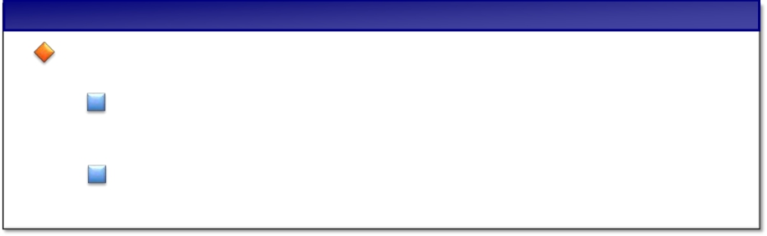

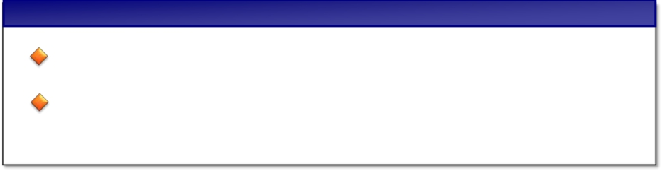
Current status and goal of Collaboration Model
Current Status
Received many inquiries from players in various business types
Inquiries from approx. 400 service providers
Concluded NDA with approx. 150 service providers
（As of Oct, 2014）
Goal of Hikari Collaboration Model
Reduce marketing cost
Stir new demands by shifting business model
from B2C to B2B2C
IR Presentation (December, 2014)
‐ 19‐
Copyright©2014 Nippon Telegraph and Telephone Corporation

Slide 21
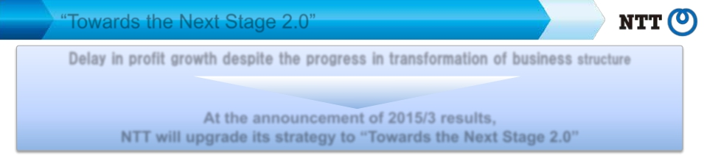
“Towards the Next Stage 2.0”
Delay in profit growth despite the progress in transformation of business structurestructure
Restart for growth in profits
At the announcement of 2015/3 results,
NTT will upgrade its strategy to “Towards the Next Stage 2.0”
Continuous Enhancement of Fundamental Business Strategies
Ⅰ
Ⅱ
Accelerate Speed of Profit Generation of “Global Cloud Services”
Continuous anticipatory investments, Combining strengths of the group, Acceleration of operational optimization
Enhance Profitability of Network Services
Cost reduction in all business processes, collaboration with various industry partners
Expansion of B2B2X Business
Support business model transformation of our clients as a “Value Partner”
Vitalization of Local Economies, innovation towards 2020, etc.
Enhance NTT’ s security business, essential for a safe and secure society
Earnings Per Share
Set new goals based on 2015/ 3 results
To raise EPS, NTT will continuously work on share buy backs, but will put more
focus on business management to increase net profit
IR Presentation (December, 2014)
‐ 20‐
Copyright©2014 Nippon Telegraph and Telephone Corporation

Slide 22
Appendix

Slide 23
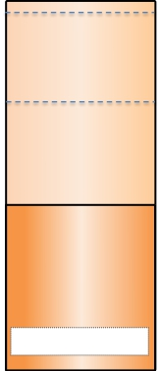

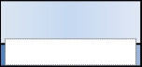

Broadband Access Services in Japan
Mobile
Fixed
Mobile
145.6M subs
eAccess
SoftBank
Mobile
KDDI
NTT DOCOMO
63.6M subs
NTT market share
Approx. 44％
～150Mbps
150M
100M
50M
Access
speed
Approx.
30M
20M
10M
Access
speed
FTTH
25.8M subs
NTTEAST and
NTT WEST
18.3M subs
NTT market share
Approx. 71％
～1Gbps
Approx.
Approx.
DSL
CATV
6.0M subs
～160Mbps
Approx.
Approx.
Approx.
4.2M subs
NTT EAST and NTT WEST
Approx.1.4M subs
NTT market share
Approx. 33％
～50Mbps
（Note） Access speeds shown are numbers used for commercial purposes, and are the maximum output speeds achievable within the framework of the respective best effort services.
（Source）MIC data (As of the end of June 2014)
IR Presentation (December, 2014)
‐ 22‐
Copyright©2014 Nippon Telegraph and Telephone Corporation

Slide 24
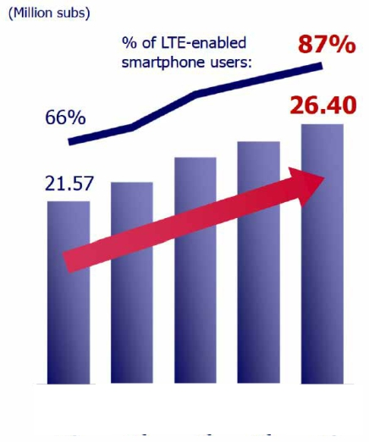
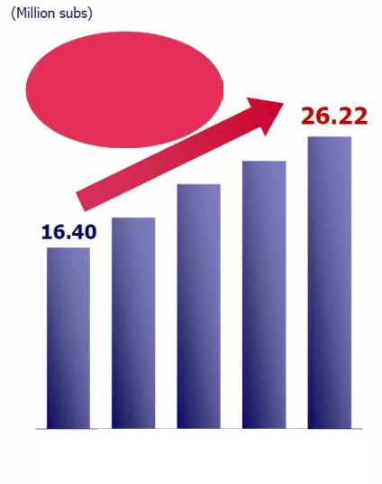
Mobile Broadband Business
DOCOMO Smartphone Users
“Xi” LTE Subscriptions
Increased by
approx.10 million
From 2014/3.2Q
2014/3
2Q
2015/3
1Q
2015/3
2Q
2014/3
2Q
2015/3
1Q
3Q
4Q
3Q
4Q
2Q
IR Presentation (December, 2014)
‐ 23‐
Copyright©2014 Nippon Telegraph and Telephone Corporation

Slide 25
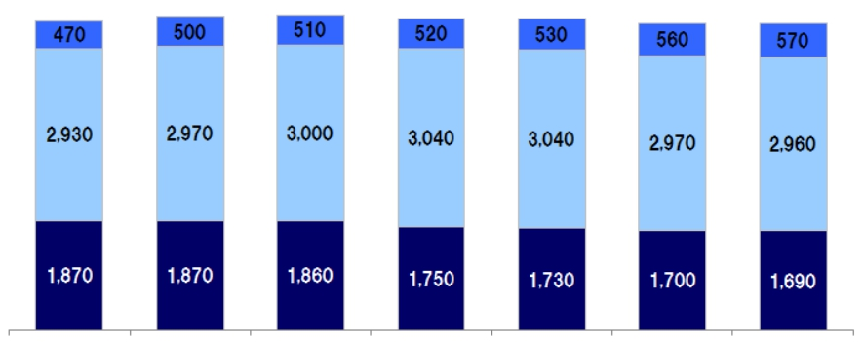
Aggregate ARPU of Mobile Broadband Business
(Exclusive of “Monthly Support ” Impact)
Voice ARPU
Packet ARPU
Smart ARPU
（Yen）
（870）
2015/ 3
Full- year
5,270
5,340
5,370
5,310
5,300
5,230
5,220
（590）
2014/ 3
1Ｑ
（660）
2Ｑ
（760）
3Ｑ
（850）
4Ｑ
（850）
2015/ 3
1Ｑ
（860）
2Ｑ
・Numbers in parentheses indicate impact of “Monthly Support” discounts
・ARPU calculation methods have been changed beginning with results presentation for the first six months of the fiscal year ending Mar. 31,2015.
Accordingly, ARPU data for the 2014/ 3 and the first quarter of 2015/ 3 have been adjusted to align with the new calculation methods.
・Smart ARPU ：A part of other operating revenues ( revenues from content services, proxy bill collection commissions, mobile phone insurance service, advertising and
others) / No. of active subscriptions( *)
forecast
( *) Active Subscriptions Calculation Methods: Sum of No. of active subscriptions for each month ( ( No. of subscriptions at the end of previous month + No.
of subscriptions at the end of current month) / 2) during the relevant period
・2013/ 3 Full- year Aggregate ARPU 4,840 Yen （ Voice ARPU 1,970 Yen, Packet ARPU 2,790 Yen, Smart ARPU 420 Yen, Monthly Support Impact - 340 Yen ）
・2014/ 3 Full- year Aggregate ARPU 4,500 Yen （ Voice ARPU 1,790 Yen, Packet ARPU 2,920 Yen, Smart ARPU 490 Yen, Monthly Support Impact - 700 Yen ）
IR Presentation (December, 2014)
‐ 24‐
Copyright©2014 Nippon Telegraph and Telephone Corporation

Slide 26
Comparison of NTT DOCOMO’ s Billing Plans
Previous Billing Plan
Basic Monthly Charges
Basic Monthly Charges
New Billing Plan
Billing Plan
Type Xi Plan Ninen
-
Monthly Fee
(Yen)
743
-
Voice Call Fee
20Yen/30sec
50minutes
2,000yen
-
Billing Plan
Kake-hodai Plan
(Smartphone/Tablet)
Kake-hodai Plan
(Feature Phone)
Data Plan
(Smartphone/Tablet)
Data Plan
(Router)
Monthly Fee
(Yen)
2,700
2,200
1,700
1,200
Voice Call Fee
Flat Rate
Flat Rate
-
-
Comprehensive
Plan
Data Plan
(voice call not included)
Comprehensive
Plan
Data Plan
(voice call not included)
＋
＋
Packet Pack Monthly Charges
(Yen)
Packet Pack Monthly Charges
(Yen)
(Yen)
Android
Tablets, etc
Android
iPhone
Tablets, etc
Xi Pake-hodai Light
Xi Data Plan Light Ninen
Xi Pake-hodai Flat
Xi Pake-hodai Double
Xi Pake-hodai for iPhone
Xi Data Plan Flat Ninen
3GB
3GB
7GB
7GB
7GB
7GB
4,700
4,700
5,700
2,000∼6,200
5,200
5,700
Data S pack
Data M pack
Data L pack
Share pack 10
Share pack 15
Share pack 20
Share pack 30
2GB
5GB
8GB
10GB
15GB
20GB
30GB
3,500
5,000
6,700
9,500
12,500
16,000
22,500
Additional Fee
per 1GB
1,000
For single
subscriptions
For Families
＋
＋
(Yen)
(Yen)
Share Option
500
Plus Xi-wari
(Packet discount for 2nd device)
*Discount of -2,861yen for 25 months (max) when 1st device is smartphone
3GB
‐ 2,861
*
Others
Zutto Docomo Discount
(Discount rate determined by subscription length)
‐ 600
*
Others
From 26th month, or when 1st device is feature phone, discount amount is -1,909 yen
U25 Ouen Discount
(Discount for subscribers to age 25＋1GB bonus packet)
*When choosing data S pack and subscription length is more than 15 years
‐ 500
IR Presentation (December, 2014)
‐ 25‐
Copyright©2014 Nippon Telegraph and Telephone Corporation

Slide 27


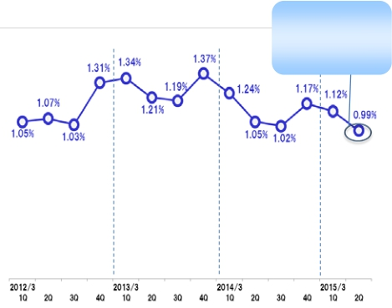




Fixed Broadband Business FTTH Subscriptions
FTTH Subscriptions (Sum of NTT East and NTT West）
（thousands subs)
*
FTTH Churn Rate (Sum of NTT EAST and NTT WEST）
Compared to
the same period
in the previous year
▲ 0.06p
18,050
18,000
16,564
17,300
17,300
18,750
16,564
15,059
15,059
13,251
11,134
2010/ 3
13,251
2011/ 3
2012/ 3
2013/ 3
2014/ 3
2015/ 3E
（Fiscal year ended/ing March 31）
**
* “ Sumof number of churn for each month of each quarter” /“ Sumof number of acti ve subscri bers for each month
of each quarter”
** Acti ve subscri bers = (number of subscri bers at end of previ ous month + number of subscri bers at the end of the
current month) / 2
IR Presentation (December, 2014)
‐ 26‐
Copyright©2014 Nippon Telegraph and Telephone Corporation

Slide 28












Fixed Broadband Business ARPU
ARPU
（Yen）
5,500
<Hikari Denwa>
Percentage of
88%FTTH users
Basic Rate
Additional Services
5,740
5,920
90%
91%
5,880
5,860
5,660
84%
1,450
1,570
1,640
1,720
1,770
1,800
16.26 17.11
Million channels
15.17
13.90 500 yen/month～
12/ 3 13/ 3 14/ 3 15/ 3E
<FLET’S TV>
Million
1.35
subscriptions
1.16
1.00
0.86
660 yen/month
12/ 3
13/ 3
14/ 3
15/ 3E
<Remote Support>
Million
subscriptions
NTT
EAST
NTT
4,290
5,780
1,460
4,310
5,890
1,580
4,280
5,940
1,650
4,140
5,880
1,730
3,890
5,830
1,800
3,700
5,720
1,830
WEST
4.60
4.67
4,320
4,310
4,290
4,150
4,030
3,890
4.53
4.30
500 yen/month～
（Fiscal year
ended/ing
March 31）
2010/ 3
2011/ 3
2012/ 3
2013/ 3
2014/ 3
2015/ 3E
12/ 3
13/ 3
14/ 3
15/ 3E
IR Presentation (December, 2014)
‐ 27‐
Copyright©2014 Nippon Telegraph and Telephone Corporation

Slide 29


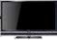
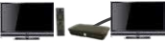
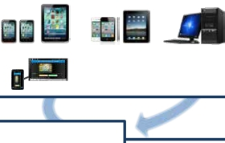
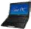

Penetration of Video Services
Million
subscriptions
4.55
3.98
Multi-Device
Hikari TV＋FLET’S TV
3.46
2.86
3.20
Tuner
(STB)
TV
TV with
Built-in tuner
New STB for Smart TV
2.82
2.01
2.45
2.00
Smartphones, tablet PCs
Car Navigation
Multi-Service
video
PC/ NotePC
music
1.28
1.01
Hikari TV
1.41
TV
book
Hikari TV ：IPTV service which distributes VOD, terrestrial digital broadcasting,
BS digital broadcasting, and multi-channel broadcasting
FLET’S TV ：Service which distributes terrestrial digital broadcasting, BS digital
broadcasting, and multi-channel broadcasting(optional), by Radio
Frequency system
karaoke
game
application
shopping
2010/ 3
2011/ 3
2012/ 3
2013/ 3
2014/ 3
2015/ 3E
（End of Year/month）
IR Presentation (December, 2014)
‐ 28‐
Copyright©2014 Nippon Telegraph and Telephone Corporation

Slide 30
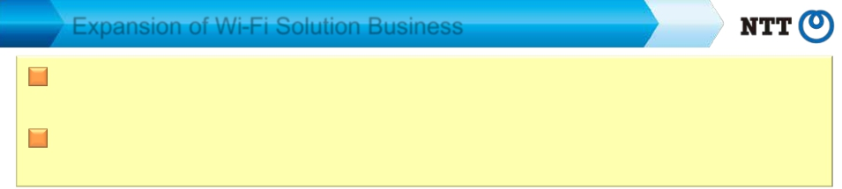

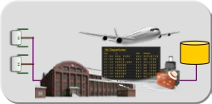


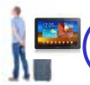
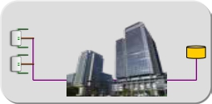



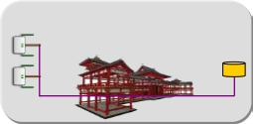


Expansion of Wi-Fi Solution Business
Enterprises and local government provide information service through Wi-Fi,
together with free Internet access
NTT Group (NTT-BP) builds the Wi-Fi network and provides the platform for
Information service
Users
Area Owners
Airports・Railway Stations
server
NTT
ＡＰ
Office buildings
Tourist spots, Art galleries,
City halls,etc.
Internet
access
（free of charge）
＋
Information
service
（charged）
Information
service
platform
（including cloud）
＋
Wi-Fi network
※ Started provision of “Japan Connected-free Wi-Fi”, which inter-connects the Wi-Fi
services provided by enterprises and local governments
IR Presentation (December, 2014)
‐ 29‐
Copyright©2014 Nippon Telegraph and Telephone Corporation

Slide 31

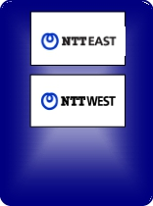
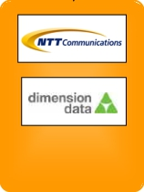



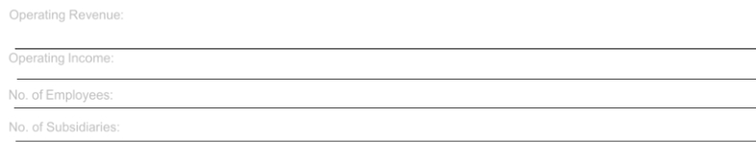
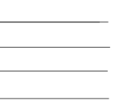
NTT Group Overview
· Operating revenues (consolidated) :10,925.2 billion yen
· Operating income (consolidated)
· No. of employees
· No. of subsidiary companies
: 1,213.7 billion yen
: 239,750
: 946
* Percentage figures show the percentage of voting rights
(March 31, 2014)
54.2％**
Other
group
companies
100％**
100％**
66.6％**
Regional
communications
business
Operating Revenue:
3,572.3 billion yen
Operating Income:
127.2 billion yen
Long distance and
international
communications
business
1,809.9 billion yen
127.5 billion yen
Mobile
communications
business
4,461.2 billion yen
817.2 billion yen
Data
communications
business
1,343.9 billion yen
67.9 billion yen
Other businesses
real estate, finance,
construction
and power business
1,328.5 billion yen
56.1 billion yen
No. of Employees:
No. of Subsidiaries:
75,850
67
38,050
339
24,850
195
75,000
263
25,950
82
(Note) Fiscal year ended March 2014. Operating revenue and operating income of each segment include inter-segment transactions.
IR Presentation (December, 2014)
‐ 30‐
Copyright©2014 Nippon Telegraph and Telephone Corporation

Slide 32

2015/3. 2Q Consolidated Financial Results
Operating Revenues increased for the fifth consecutive year due to the growth of overseas
businesses.
Operating Income decreased due to a larger decrease in profit of the Mobile communications
segment despite an increase in profit of the Regional communications segment and the Data
communications segment.
(Billions of yen)
2015/3
FY2014/2Q
Change
year-on-year
+107.6
+169.7
(62.1)
(33.2)
2Q
2014/3
FY2013/2Q
2Q
5,266.1
4,613.0
653.0
323.5
% Year-on-Year
Increase
(Decrease)
+2.0%
+3.7%
(9.5)%
(10.3)%
Operating
Revenues
Operating
Expenses
Operating
Income
Net Income
5,373.7
4,782.7
590.9
290.3
*
*
IR Presentation (December, 2014)
Net income represents net income attributable to NTT, excluding noncontrolling interests.
‐ 31‐
Copyright©2014 Nippon Telegraph and Telephone Corporation

Slide 33
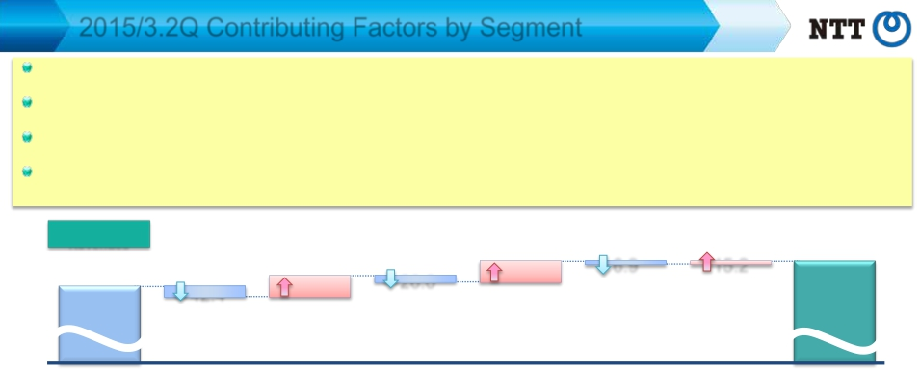

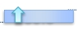
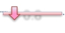
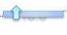


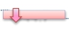


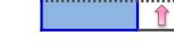
2015/3.2Q Contributing Factors by Segment
Regional communications business: Operating Income increased as a result of continued efforts to improve operational efficiency, despite the
increased impact of FLET’S Hikari discounts.
Long distance and international communication business: Although Operating Income decreased year-on-year, profit improvement in overseas
businesses contributed to an increase in profit for the six-month period ended September 30.
Mobile communications business: Operating Income decreased due to the increased impact of “Monthly Support” discount programs and the effect of
new rate plans to decrease Operating Revenues.
Data communications business: Operating Income increased due to the effect of reducing unprofitable transactions, in addition to the improvement of
gross margin in conjunction with an increase in sales.
Operating
Revenues
5,266.1
2014/3.2Q
[year-on-year：+107.6]
86.1
Regional Long distance and
communications
international
business
communications
business
Mobile
communications
business
26.0
Data
communications
business
81.7
Other
business
6.9
(Billions of yen)
15.2
Elimination of
5,373.7intersegment/Others
2015/3.2Q
42.4
Operating
Expenses
4,613.0
2014/3.2Q
Operating
Income
2014/3
2Q
[year-on-year：+169.7]
91.2
Long distance and
communications
business
[year-on-year： (62.1)]
Regional
Long distance and
international
communications
communications
business
business
60.6
Data
communications
business
Data
communications
business
0.8
Other
business
Other business
16.6
Elimination of
intersegment/Others
Elimination of
intersegment/
Others
46.8
Mobile
communications
business
Mobile
communications
business
44.7
4,782.7
2015/3.2Q
2015/3
2Q
Regional
international
communications
business
653.0
2.2
5.1
72.8
21.1
6.1
1.5
590.9
IR Presentation (December, 2014)
‐ 32‐
Copyright©2014 Nippon Telegraph and Telephone Corporation

Slide 34
Consolidated Forecasts for 2015/3
Forecasts for both Operating Revenues and Operating Income have been adjusted due to the
higher-than-expected spread of new rate plans
(Billions of yen)
FY2014
Forecasts
Change
from Initial
Forecasts
2015/3
% Progress
(Billions of yen)
FY2014
Forecasts
2015/3
Compared to
FY2014/2Q
2Q
2015/3
Operating Revenues
Operating Expenses
Operating Income
Net Income
EPS(yen)
11,010.0
9,915.0
1,095.0
529.0
479.00
(190.0)
(70.0)
(120.0)
(57.0)
(57.00)
5,373.7
4,782.7
590.9
290.3
48.8%
48.2%
54.0%
54.9%
*
*
Net income represents net income attributable to NTT, excluding noncontrolling interests.
IR Presentation (December, 2014)
‐ 33‐
Copyright©2014 Nippon Telegraph and Telephone Corporation

Slide 35
Trend in Consolidated Financial Results
10.9
1.21
0.59
1.30
509
11.0
1.10
0.53
1.14
479
10.7
1.20
0.52
1.24
431
■■ Operating
Revenues
（Trillion yen）
■■ Operating
Income
（Trillion yen）
■■ Net Income
（Trillion yen）
■■ Operating FCF
（Trillion yen）
■■ EPS
（yen）
10.5
1.22
0.47
1.27
367
10.2
1.12
0.49
1.25
372
10.3
1.21
0.51
1.41
385
Fiscal year ended/ing
March 31
2010/ 3
2011/ 3
2012/ 3
2013/ 3
2014/ 3
*
2015/ 3E
*Includes influence of 60 billion yen of non-operating revenues by The Otemachi 2-Chome Area Redevelopment Project .
(Note) Operating FCF＝EBITDA-Capex
IR Presentation (December, 2014)
‐ 34‐
Copyright©2014 Nippon Telegraph and Telephone Corporation

Slide 36
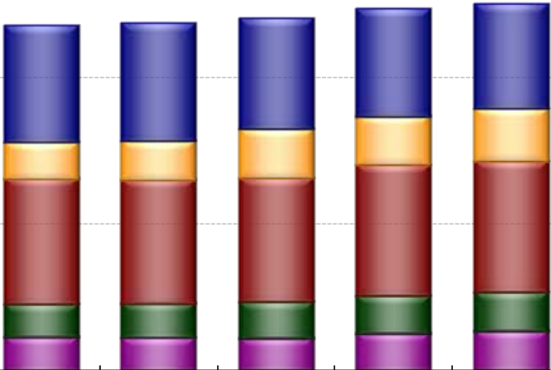

Changes in Consolidated Operating Revenues
：Regional communications business
：Long distance and international
communications business
Consolidated
：Mobile communications business
Operating Revenues
（billion yen）
：Data communications business
：Other business
10,925.2
11,010.0
10,507.4
10,700.7
10,181.4
10,305.0
3,659.8
1,657.9
4,470.1
1,303.5
1,251.9
2013/ 3
3,572.3
1,809.9
4,461.2
1,343.9
1,328.5
2014/ 3
10,000
5,000
0
(Fiscal year
ended/ing March 31)
3,964.3
1,259.6
4,284.4
1,132.5
1,132.6
2010/ 3
4,027.2
1,332.7
4,224.3
1,163.2
1,120.3
2011/ 3
3,764.8
1,678.7
4,240.0
1,251.8
1,089.0
2012/ 3
2015/ 3E
(Note) Business segment operating revenues include inter-segment transactions
IR Presentation (December, 2014)
‐ 35‐
Copyright©2014 Nippon Telegraph and Telephone Corporation

Slide 37
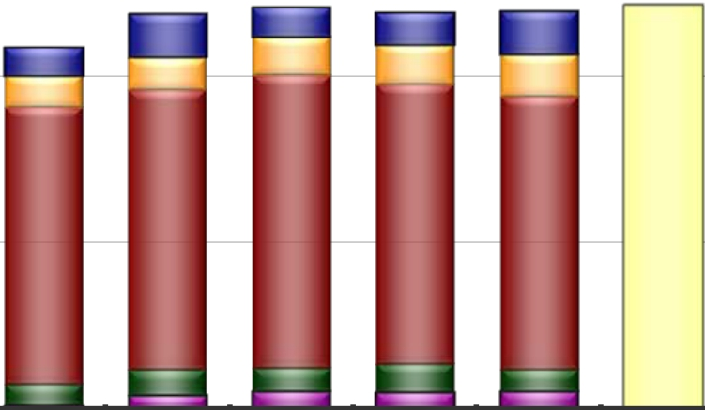
Changes in Consolidated Operating Income
：Regional communications business
：Data communications business
Consolidated
Operating Income
（billion yen）
：Long distance and international
communications business
：Mobile communications business
：Other business
1,214.9
1,223.0
1,202.0
1,213.7
1,095.0
127.3
97.1
839.1
77.0
44.9
2011/ 3
86.9
116.7
876.4
71.5
56.9
2012/ 3
93.0
121.3
836.4
85.8
53.3
2013/ 3
127.2
127.5
817.2
67.9
56.1
2014/ 3
1,117.7
82.1
98.2
828.4
64.9
2010/ 3
1,000
500
0
(Fiscal year
13.3
2015/ 3E
ended/ing March 31)
(Note) Business segment operating income include inter-segment transactions
IR Presentation (December, 2014)
‐ 36‐
Copyright©2014 Nippon Telegraph and Telephone Corporation

Slide 38

Changes in CAPEX
（Billions of yen）
3,000
CAPEX / Sales
19.4%
20.0%
18.0%
18.4%
18.1%
2,500
2,000
1,500
1,000
500
0
(Fiscal year
ended/ing March 31)
16.7%
1,795.7
( 1,892.8)
401.9
( 499.0)
703.1
690.7
2014/ 3
16.1%
1,750.0
( 1,890.0)
420.0
( 560.0)
690.0
640.0
2015/ 3E
1,947.4
( 1,987.1)
414.9
( 454.6)
686.5
846.0
2010/ 3
1,906.5
( 1,946.6)
395.5
( 435.6)
726.8
784.2
2012/ 3
1,907.5
( 1,970.0)
398.8
( 461.3)
753.7
755.0
2013/ 3
15.0%
10.0%
5.0%
0.0%
1,829.6
( 1,870.1)
381.5
( 422.0)
668.5
779.6
2011/ 3
Others
NTT
DOCOMO
NTT EAST
＋
NTT WEST
(Note) Amounts shown in parentheses include sales and investments related to real estate and solar power generation operations.
CAPEX to Sales including sales and investments related to real estate and solar power generation operations are as follows;
2010/3：19.5%, 2011/3：18.1%, 2012/3：18.5%, 2013/3：18.4%,2014/3：17.3%, 2015/3（E）：17.2%
IR Presentation (December, 2014)
‐ 37‐
Copyright©2014 Nippon Telegraph and Telephone Corporation

Slide 39

Changes in Interest-bearing Debt
Interest-bearing
Debt
（billion yen）
6,000
Debt ratio*
36.6%
4,491.7
2010/ 3
36.2%
4,553.5
2011/ 3
40.0%
30.0%
20.0%
10.0%
0.0%
5,000
4,000
3,000
2,000
1,000
0
(Fiscal year
35.2%
4,274.0
2012/ 3
33.8%
4,400.0
2015/ 3E
32.9%
4,036.0
2013/ 3
33.0%
4,200.0
2014/ 3
ended/ing March 31)
* Debt ratio = Interest-bearing debt / (Interest-bearing debt + Shareholders’ equity) x 100
IR Presentation (December, 2014)
‐ 38‐
Copyright©2014 Nippon Telegraph and Telephone Corporation

Slide 40

Changes in Number of Employees
：Regional communications business
：Long distance and international
communications business
：Data communications business
：Other business
Consolidated No. of
employees
：Mobile communications business
239,750
241,350
222,150
226,650
227,150
200,000
196,900
75,850
71,100
88,300
81,300
94,350
100,600
38,050
40,900
31,150
33,450
29,350
24,850
26,100
100,000
23,300
23,900
14,200
22,950
22,300
34,550
25,250
77,550
25,650
61,350
27,150
75,000
25,950
50,000
25,500
58,650
25,250
0
2010/ 3
2011/ 3
2012/ 3
2013/ 3
2014/ 3
2015/ 3E
（End of Year/month）
IR Presentation (December, 2014)
‐ 39‐
Copyright©2014 Nippon Telegraph and Telephone Corporation

Slide 41



Age Distribution of Employees at NTT East, NTT West and
“Outsourcing Companies” (As of March 31, 2014）
8,000
6,000
4,000
2,000
0
Number of Employees
20
30
40
50
60
65
Age
(Note) Figures for East Outsourcing Companies include the consolidated prefectural outsourcing companies (NTT EAST-TOKYO and others), NTT-ME and NTT EAST
SOLUTIONS. while figures for West Outsourcing Companies include NTT BUSINESS SOLUTIONS, NTT MARKETING ACT, NTT NEOMEIT, NTT FIELDTECHNO and NTT
BUSINESS ASSOCIE WEST. Figures for those companies include the number of more than 60-year-old contracted employees.
‐ ‐
IR Presentation (December, 2014)
40
Copyright©2014 Nippon Telegraph and Telephone Corporation

Slide 42

Share Buy Backs and Cancellation
Buy back
from market
Buy back
from market
Cancellation
Buy back
from Gov’t,etc.
＜＞：share holding ratio
99mil. shares
Gov’t
Owned
Shares
431mil.
shares
<33％>
793mil.
shares
Treasury
Stocks
<10.4%>
99mil. shares
38mil. shares
Gov’t
Owned
Shares
431mil.
shares
<33％>
755mil.
shares
Treasury
Stocks
<14.1%>
138mil. shares
49mil. shares
Gov’t
Owned
Shares
431mil.
shares
<33％>
705mil.
shares
Treasury
Stocks
<0.0%>
Cancellation
-187 mil. shares
Excess
Holdings
62mil. shares
Gov’t
Owned
Shares
431mil. shares
<39％>
705mil.
shares
Treasury
Stocks
<2.3%>
26mil. shares
Market
floating
shares
705mil.
shares
Treasury
Stocks
＜5.8％＞
26mil. shares
39mil. shares
Gov’t
Owned
Shares
369mil
<33％>
Market
floating
shares
702mil.
shares
Excess
Holdings
36mil. shares
Gov’t
Owned
Shares
405mil. shares
<37％>
※
Mar. 31, 2012 Mar. 31, 2013
Oct. 31, 2013
Nov. , 2013
Mar. , 2014
Nov. , 2014
Total number of shares issued (million shares)
1,323
※ Mandatory (minimum) number of shares to be held by the Government under the NTT Law
= （total number of shares issued－30 million shares issued at the IPO in 2000) × 1/3
1,137
*The number of shares issued after the initial listing are not to be included in the calculations. (NTT Law, supplementary provision 13)
IR Presentation (December, 2014)
‐ 41‐
Copyright©2014 Nippon Telegraph and Telephone Corporation

Slide 43

Next V alue P artner
T ransformation
T rusted S olutions
andFull-lineICT services
for
of BusinessmodelsandLifestyle
by
ofGlobal,Secure,End-to-end,

